Slide 1
Harju Elekter Group
Q2 and 6M 2021

Slide 3
Harju Elekter Group
AS Harju Elekter Elektrotehnika
AS Harju Elekter Teletehnika
Energo Veritas OÜ (80.52%)
Harju Elekter Oy
Telesilta Oy
Harju Elekter Kiinteistöt Oy
AS Harju Elekter
Harju Elekter AB
Harju Elekter Services AB
Harju Elekter UAB

Slide 4
Harju Elekter Group
Strategic Investments:
OÜ Skeleton Technologies Group (7.22%) Developer and manufacturer of ultra-capacitors
SIA Energokomplekss (14%) MV/LV equipment sales organisation in Riga
IGL-Technologies Oy (5.5%)
Technology company developing parking and electric vehicles charging systems

Slide 6
Harju Elekter Group in numbers (6 months 2021)
67.0 million
Revenue
(6M 2020: 74.0)
1.2 million
EBIT
(6M 2020: 3.2)
0.8 million
Net profit
(6M 2020: 2.7)
10
Companies
868
Employees
7
Industrial Real-Estate
in Estonia, Finland, Lithuania

Slide 7
Production

Slide 8
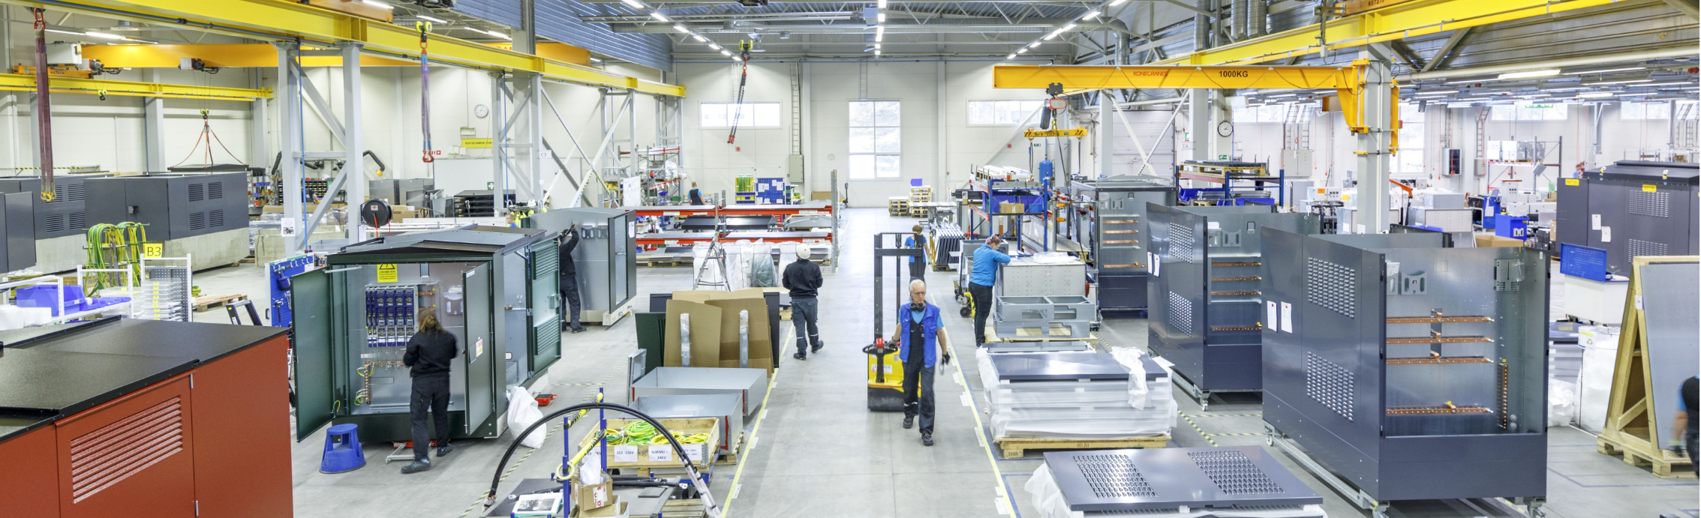
Renewable Energy
Energy
Our solutions are for
e-Mobility
Engineering and manufacturing
Industry & Automation
Marine
Rail & Infra
Communication

Slide 9
Our Customers
Electricity producers
Electricity transfer and distribution networks
Electricity consumers
energy intensive industry, infrastructure, marine, households

Slide 10
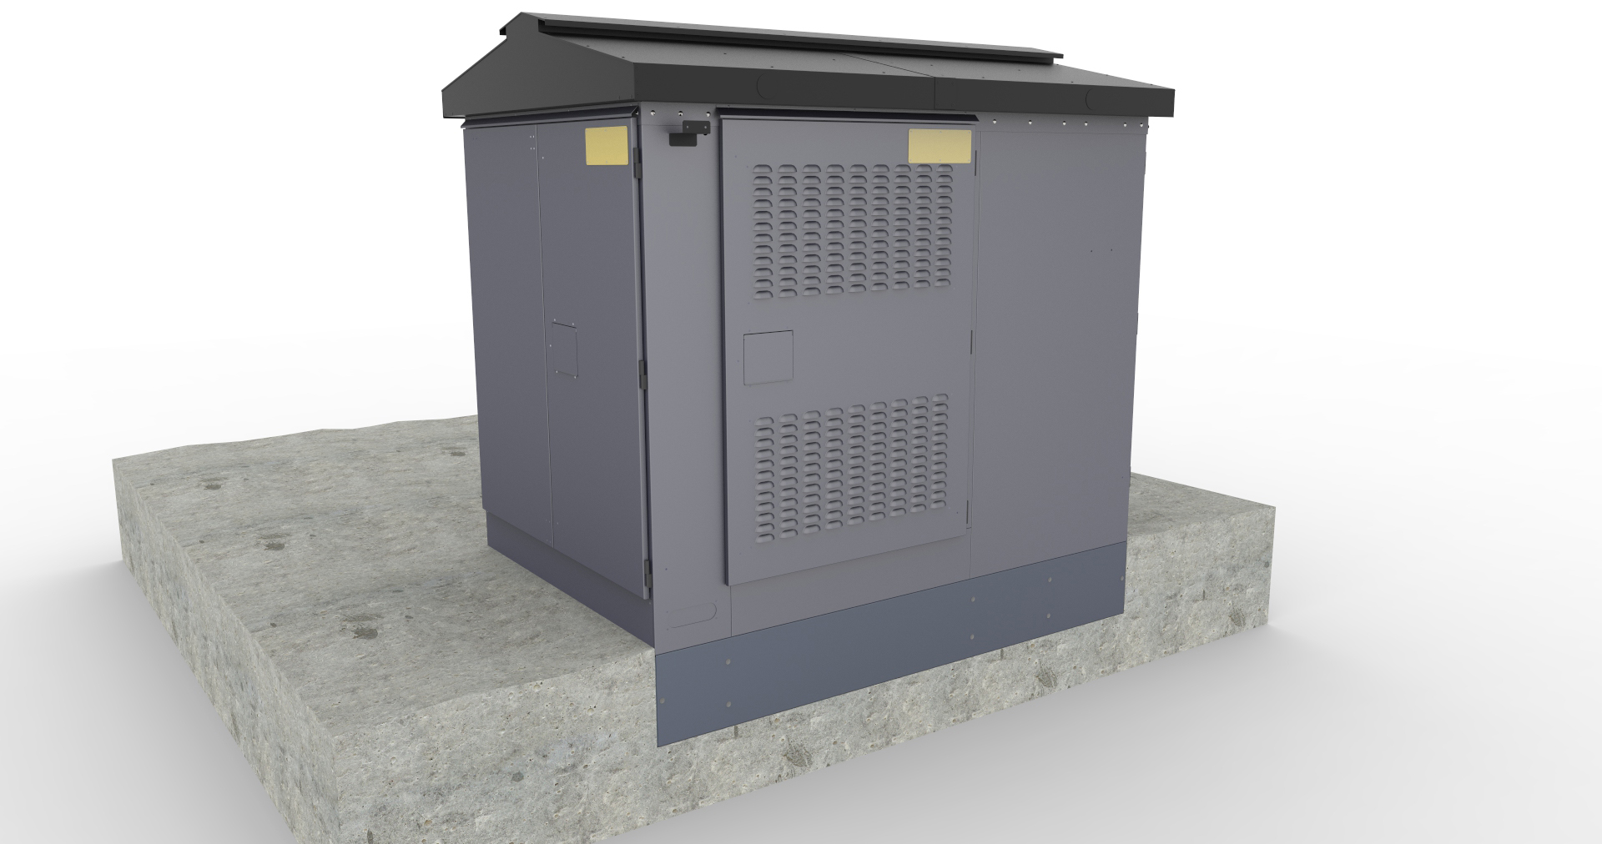
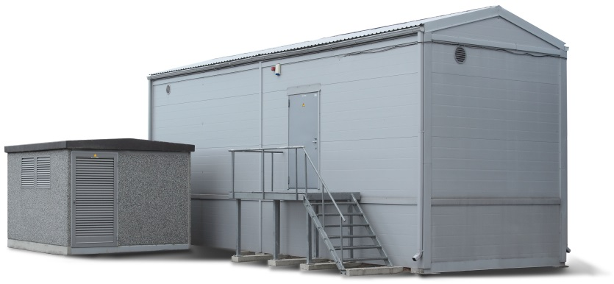
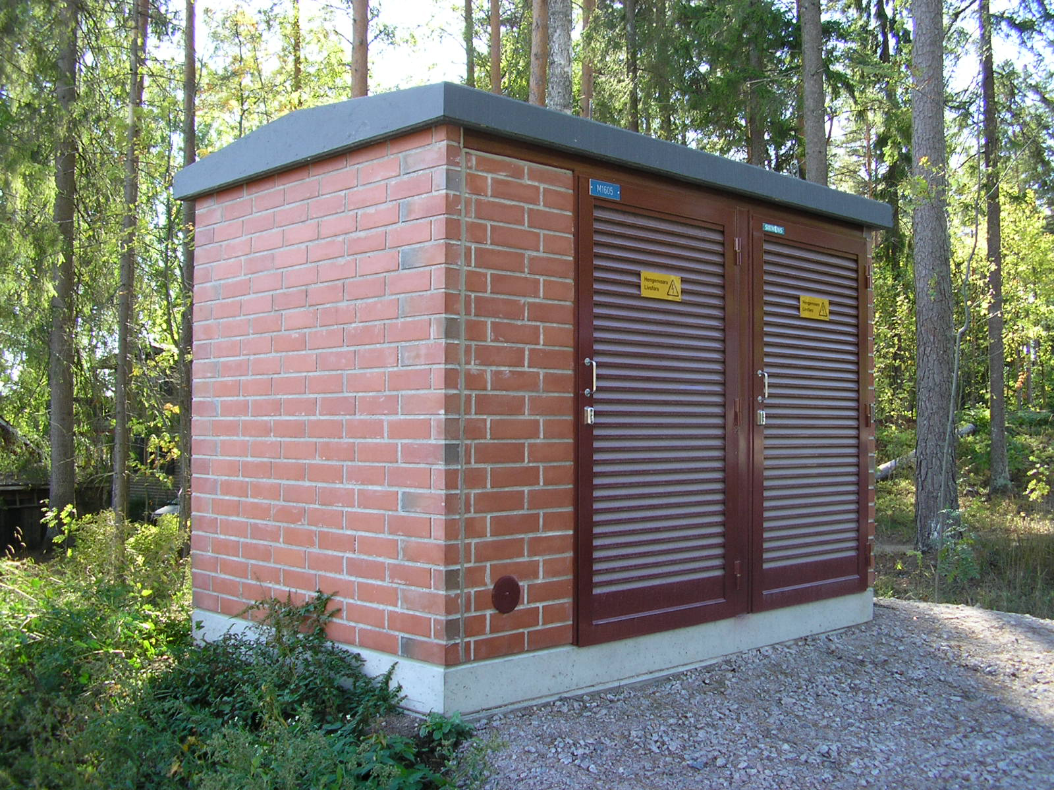
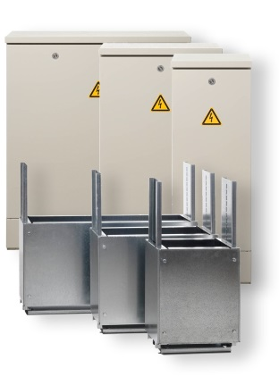
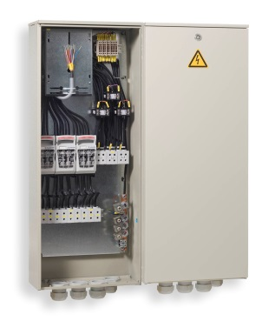
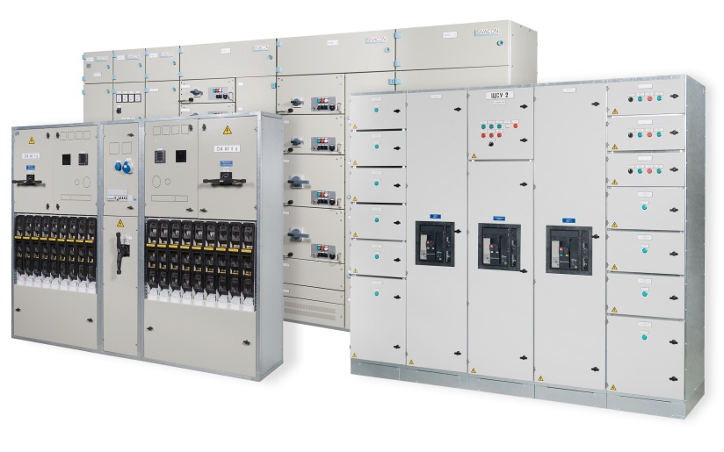
Equipment for energy distribution sector
HEJA-HESA
Prefabricated MV Electric Centres & Energy Storages
HEKA - B
Prefabricated MV/LV Substations (CCS)
HEKA - M
Prefabricated MV/LV Substations (CCS)
HEMP, 8HS, 8PU, 8PT
LV Power Distribution Boards
HETR
Cable Distribution Cabinets
HELK
Metering Cabinets

Slide 11
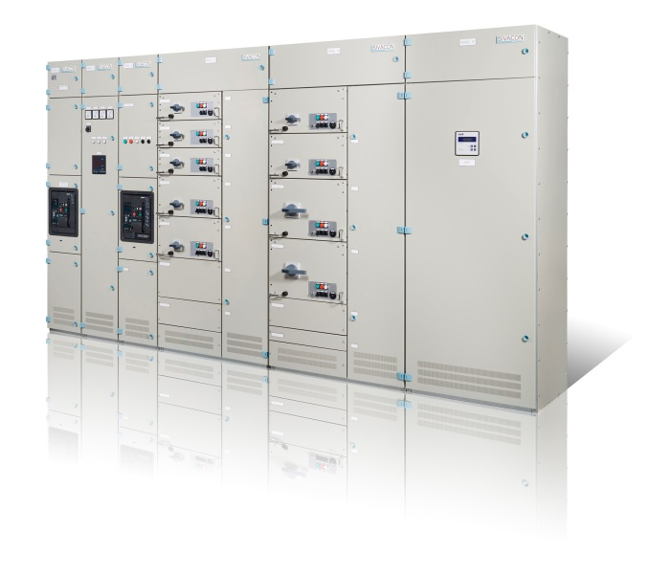
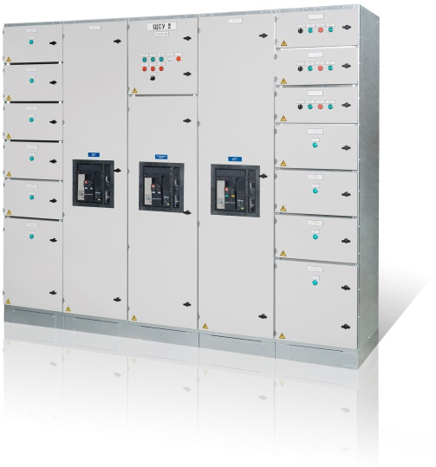
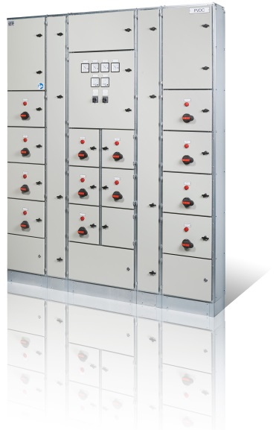
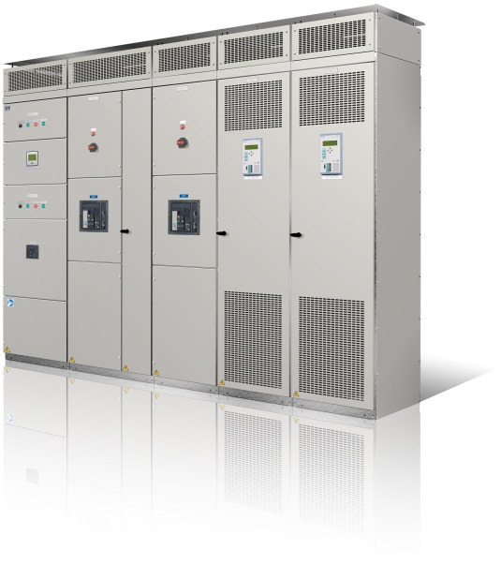
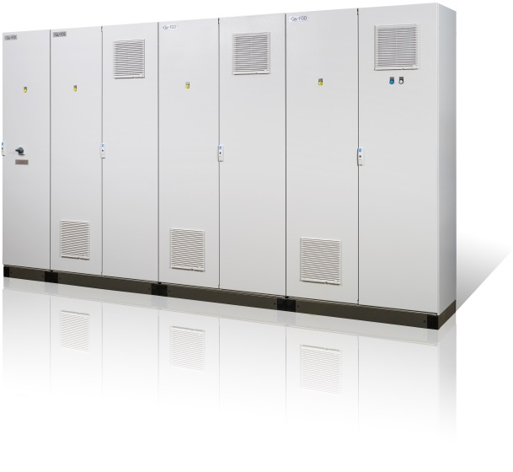
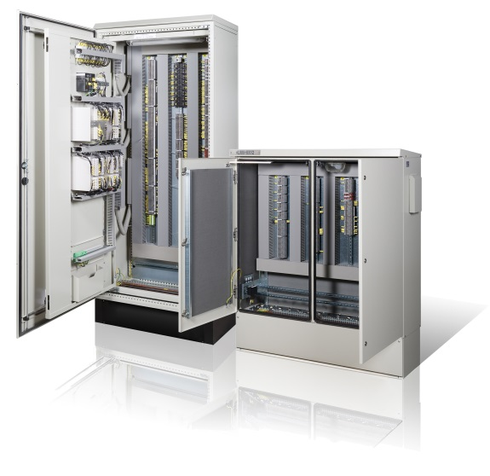
Equipment for industry sector
HE 8PT – Sivacon
Motor Control Centers
HE 8HS
Modular Switchgears
HE 8HR
Modular Switchgears
HEVA
Power Drive Centers
HERI
Automation & Drive Switchgears
and special Switchgears

Slide 12
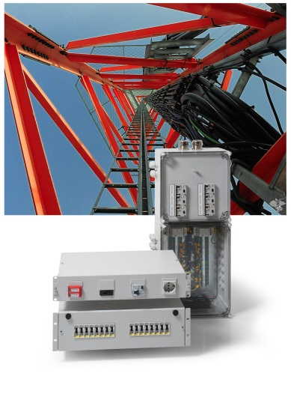
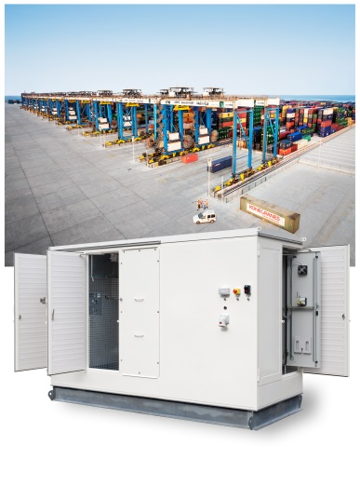
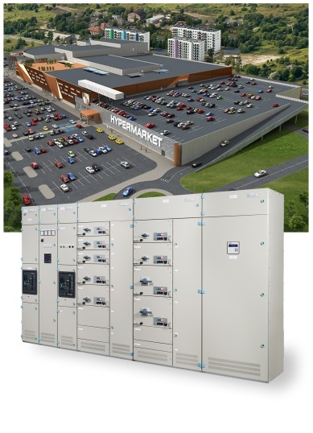
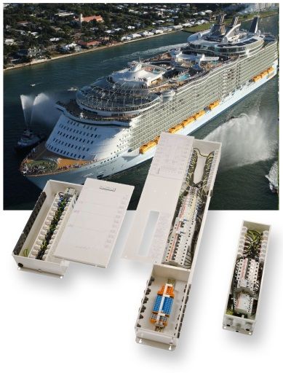
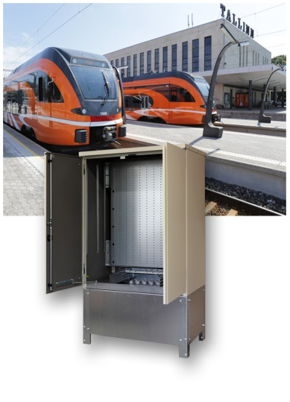
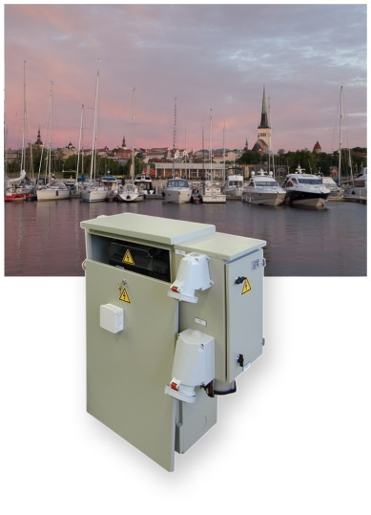
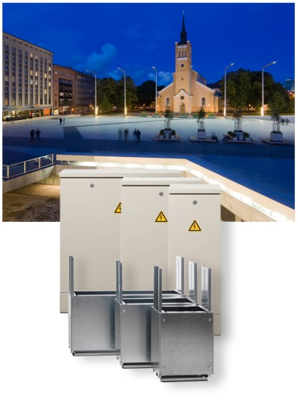
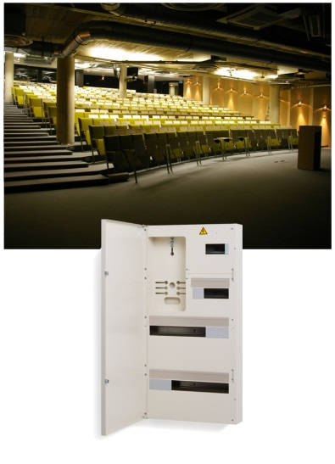
Equipment for building sector and infrastructure

Slide 13
Customers and partners

Slide 14
Real Estate

Slide 15
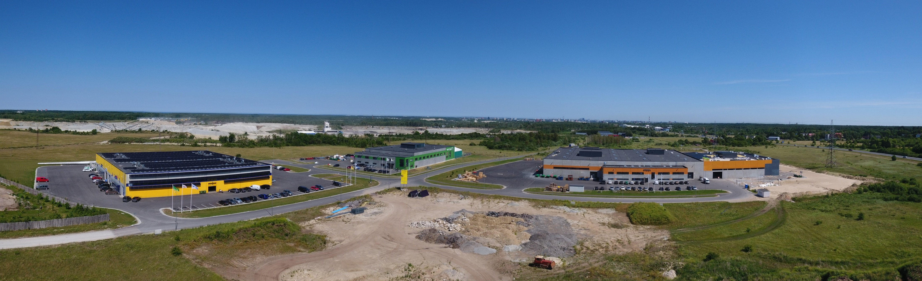
Real estate development and management
115,182 m²
75,23 ha
7
Production, office, and ware-house premises
Properties
Industrial parks in Estonia, Finland, Lithuania

Slide 16
Financial Indicators

Slide 17
Q2 2021 Key Indicators mln eurot
 | Q2 2021 | Q2 2020 | +/- | 2020
Revenue | 36.3 | 39.0 | -6.9% | 146.6
Operating profit (EBIT) | 0.7 | 2.2 | -69.8% | 6.5
EBITDA | 1.6 | 3.1 | -46.9% | 10.3
Profit for the period | 0.5 | 2.0 | -75.2% | 5.6
Earnings per share (EPS) (euros) | 0.03 | 0.11 | -75.5% | 0.31
Investments, 6M | 3.9 | 2.2 |  | 8.1
Employees, 30.06 | 868 | 829 | 39 | 784

Slide 18
67.0 million
Revenue
6M 2021
EUR ‘000

Slide 19
7,983
Shareholders
(30.06.2021)

Slide 20
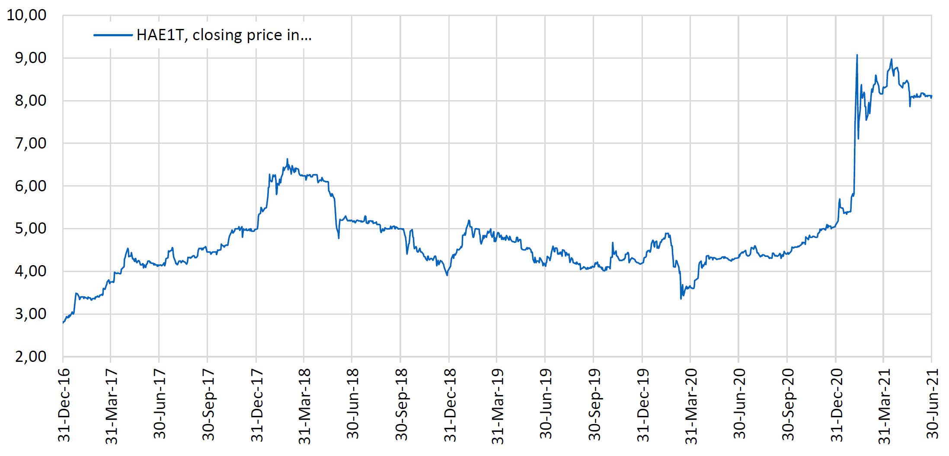
Share price in Stock Exchange Nasdaq Tallinn
8.18

Slide 21
www.harjuelekter.com
#harjuelekter

